Slide 1

BLACK FRIDAY SALES
BY : SUYOG HOLE

Slide 2
Problem Statement : Build A Model To Predict The Purchase Amount Of Customers Against Various Products Which Will Help Them To Create Personalized Offers For Customers Against Different Products.

Slide 3
About DATA
Black Friday Sales Dataset
By Retail Stores
550,000 Observations
Contains:
Numerical Variables
Categorical Variables
On Google : Over 62% Of Buyers Think Black Friday Is Just A Scam
To Get People To Spend More Money Than They Normally Would ?
Let’s See What Data Says .

Slide 4
Data analysis Process
Data Got From Client
Data Gathering
Exploring Data
Cleaning Data
Final Formatting Of Data
Building Ml Algorithms

Slide 5
Python Packages Used
Using Python
Sampling
Used Libraries: Pandas ,Numpy ,Matplotlib ,Seaborn ,Sklearn ,Stats .

Slide 6
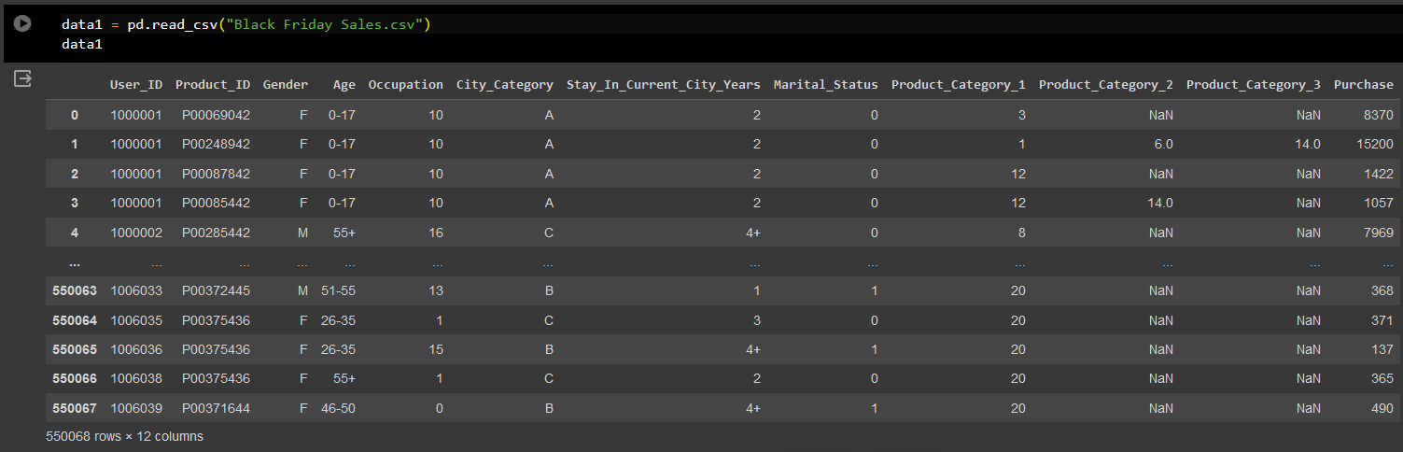
Attributes in Data
User_ID (Numerical Variable)
Product_ID (Categorical Variable)
Gender (Categorical Variable)
Age (Categorical Variable, because it is in ranges)
Occupation (Numerical Variable)
City_Category (Categorical Variable)
Stay_In_Current_City_Years (Numerical Variable)
Marital_Status (Numerical Variable)
Product_Category_1 (Numerical Variable)
Product_Category_2 (Numerical Variable)
Product_Category_3 (Numerical Variable)
Purchase Amount in dollars (Numerical Variable)

Slide 7
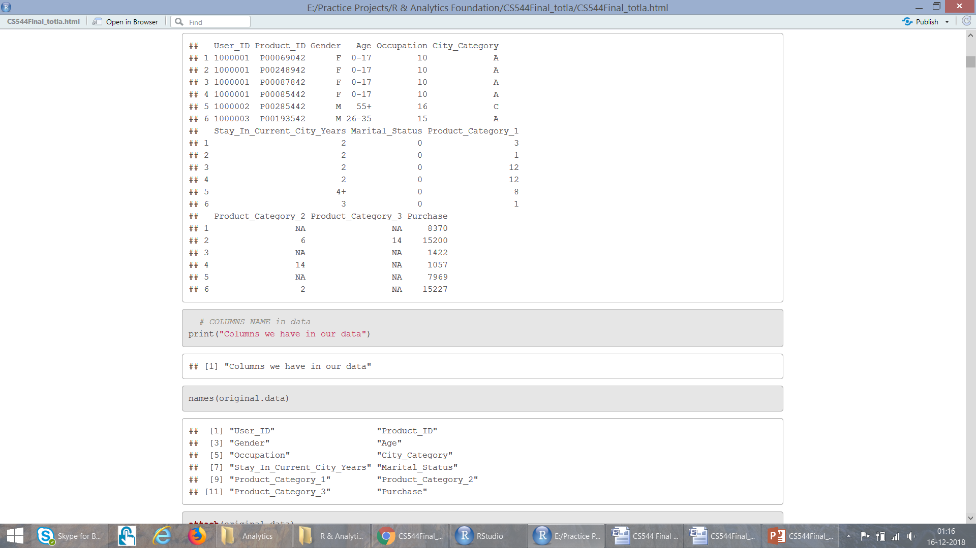
Exploring Attributes
User Id: Not Unique, maps person to the particular purchase
Product Id: Not Unique, tells how many purchases are made for a product
Gender: Have only two variables: F M
Age: It is divided into 7 ranges, Here Age is Categorical Variable
Occupation: There are 21 different occupation ranging from 0-21
City Category: Cities in which customers have lived is categorized into three categories: A, B, C
Year.. : People have lived in the current city for 0-4 years
Marital Status: People have their marriage status marked as either 0 or 1
Product Category 1: Ranges form 1-18
Product Category 2: Ranges form 2-18
Product Category 3: Ranges form 3-18
Purchase: It is the amount people spent in $ for purchases. Not unique.

Slide 8
Analysis..

Slide 9
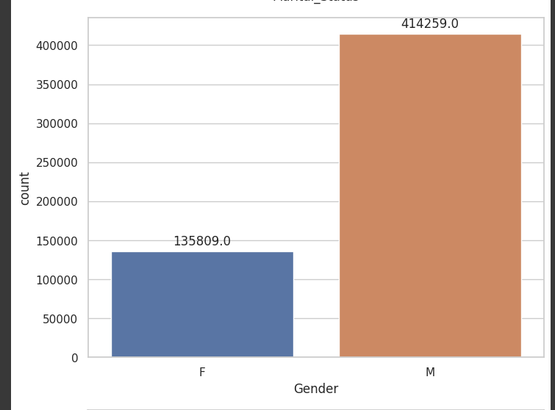
Analyse Gender
Bar-plot Shows Count Of Customers Which Include Two Types Of Categories Where The Count Of Male Customers Are High From 5+ Lakh Customers .
It Denotes Some Possibilities :
Product Categories Of Male Are More .
Where The Data Came Have More Count Male Gender.
Male Customers Are More Bias Towards Buying Online Products.
The Count Of Male Customers Are Loyal.
Female Gender Are Using Male Gender Id To Order Products.

Slide 10
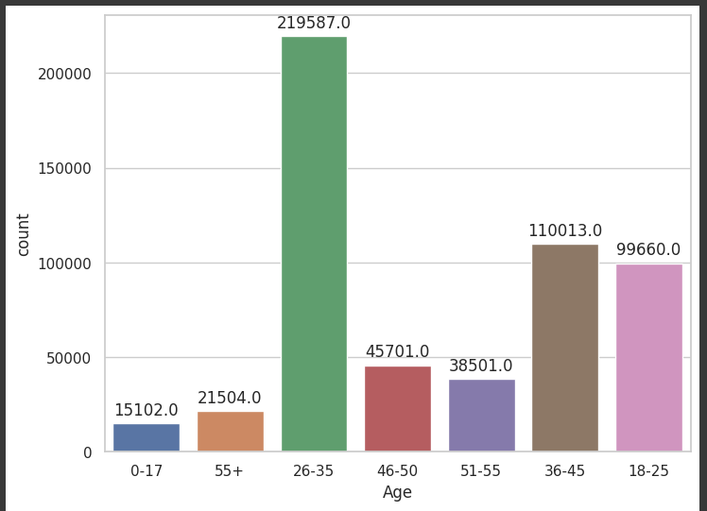
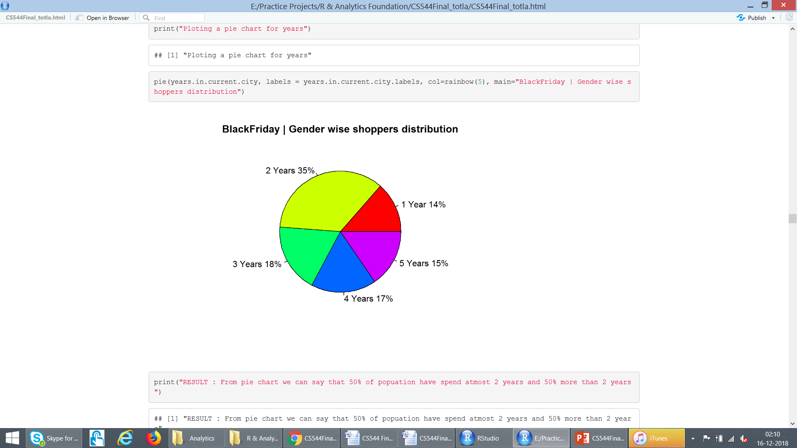
Analyse Age-Range
The Feature Age Contain Data Of Customers In A Range Of 0-17 ,18 -25 …
We Don’t Have Data Of Every Customer Accurate Age Which Gave Less Complexity To Recommend More Product In That Range .
Where Customers Which Are In Range Of 26 -35 Are More Bias Towards Shopping Online.
Assumptions :
The Data Which We Have Of Black Friday Sales Where Category Of Product Most Have In Website Or App Which Like That Specific Age Group.
The Company Is Targeting Youth To Buy Their Products.

Slide 11
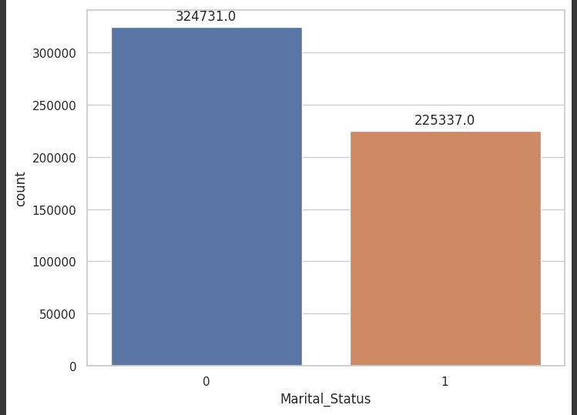
Analyse Marital Status
Seems We Have More Single Or Divorce Customers Which Are Buying Product Compare To Married People .
It Indicates The Product Have In Website Or Apps Is
Targeting Both But Due Male Buyers More
That Contributing More .
It’s Says There Are More Male Which Are Single.

Slide 12
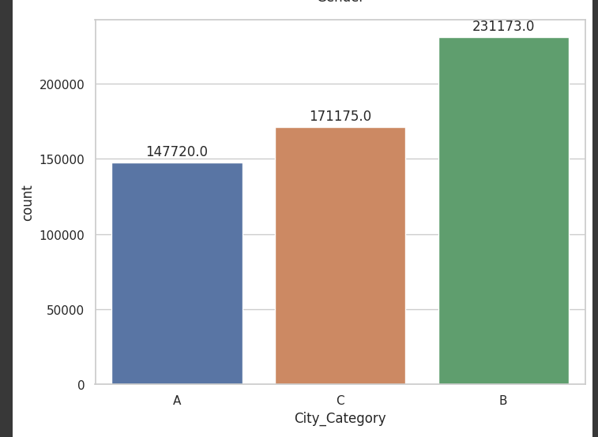
Analyse City Categories
We Have Data Of Three 3 Categories Of City That May Tiers Or Particular City .
Count From City Is More Towards Buying Online Product Their We Have More Repetitive Rate Of Product And There Are More Loyal Customers Or They Got More Offer Than A And B.

Slide 13
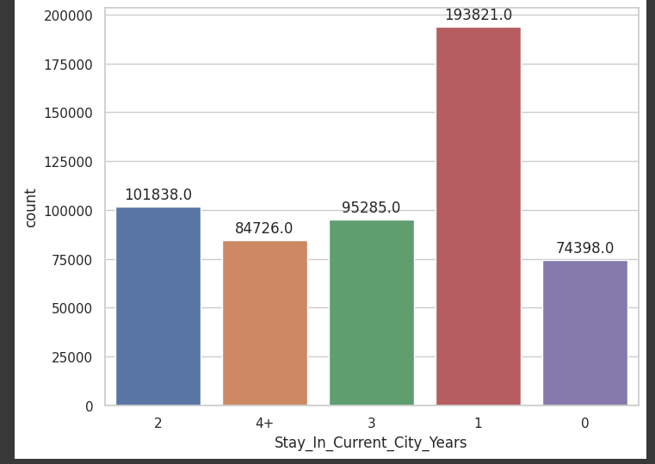
Analyse Years in current city
Customer Who Lived In Current City From
Less Than 1 Year To 4 + Counting.
It’s Show Who Shifted To Tier A , B ,C Cities With At Least One Year They Shop More Compared To Who Live In Less Than One And Greater Than One .
The Graph Shows Count Of People Who Live And From Other Analysis We Can Say A Good Percent Of Customers Who Are Unmarried And Lived At Tier B City With Less Than One Year Of Stay They Are Ordering More Compared To Other Customer .

Slide 14
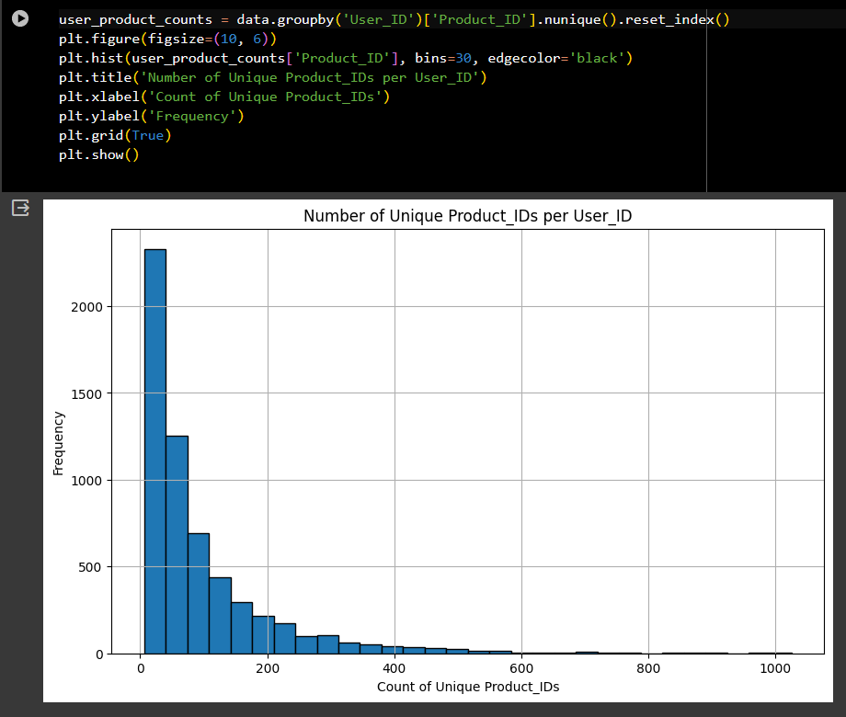
Analysis unique product
After Converting Product Id Into Normal Form To Understand And Get Insights From We Can See More Than 80% Of Product Are Having Repetition In Orders Makes Sales Profitable
Assuming:
Product Have High Demand And Supply Is High Due To That Having More Repetitive Order Of Product .
Those Product May Essential Likes Groceries Or Festival Things.
Eg . Like In Covid Sales Of Mask , Sanitizers ,Medicines Etc Is Spike And This Product Having Repetitive Order And Supply Is Also Good An Discounted Price.

Slide 15
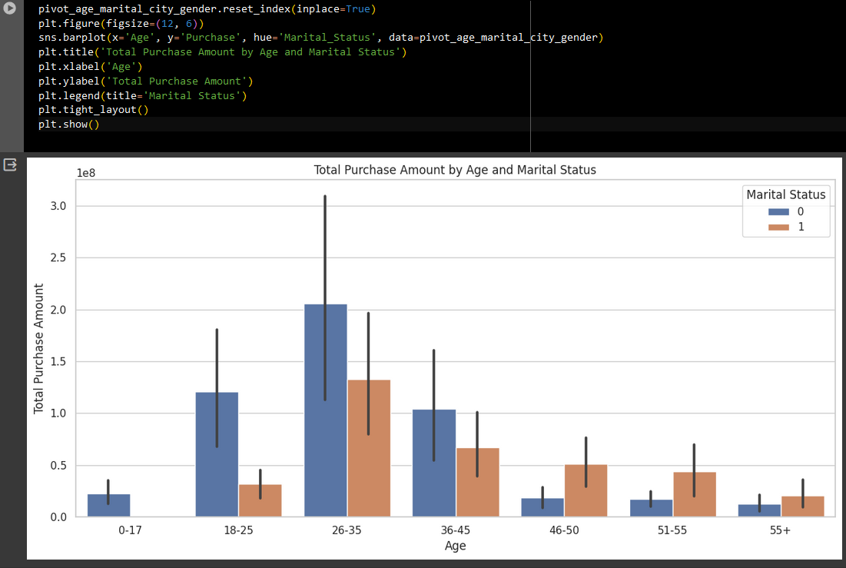
Multivariate Analysis
Graph Show Total Purchase Wrt To Marital Status And Age Of Customers .
Insights :
As Pervious Univariate Graph Show The Age Group
People Between 26-35 Are Shopping More
Specially Unmarried

Slide 16
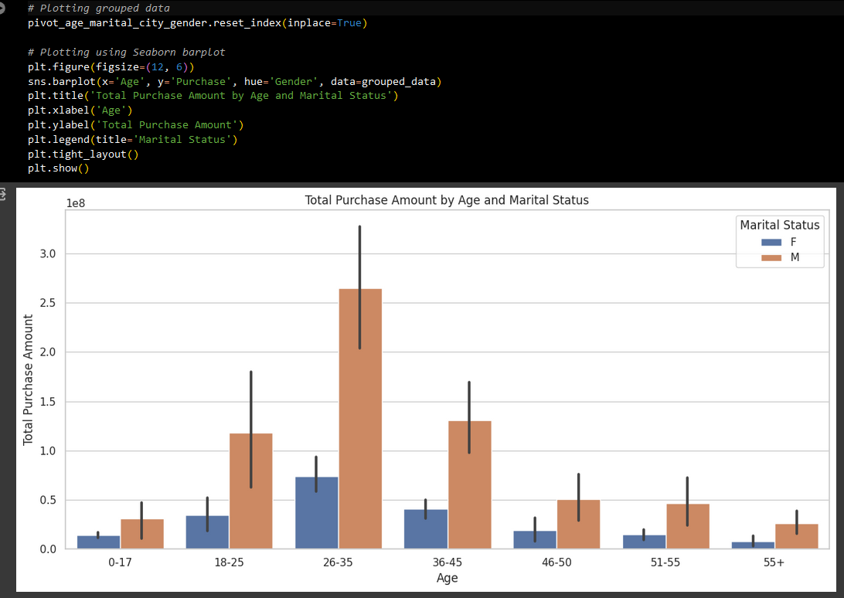
Graph Show Total Purchase Wrt To Gender And Age Of Customers .
Insights :
As Pervious Univariate Graph Show The Age Group People Between 26-35 Are Shopping More Specially Male .

Slide 17
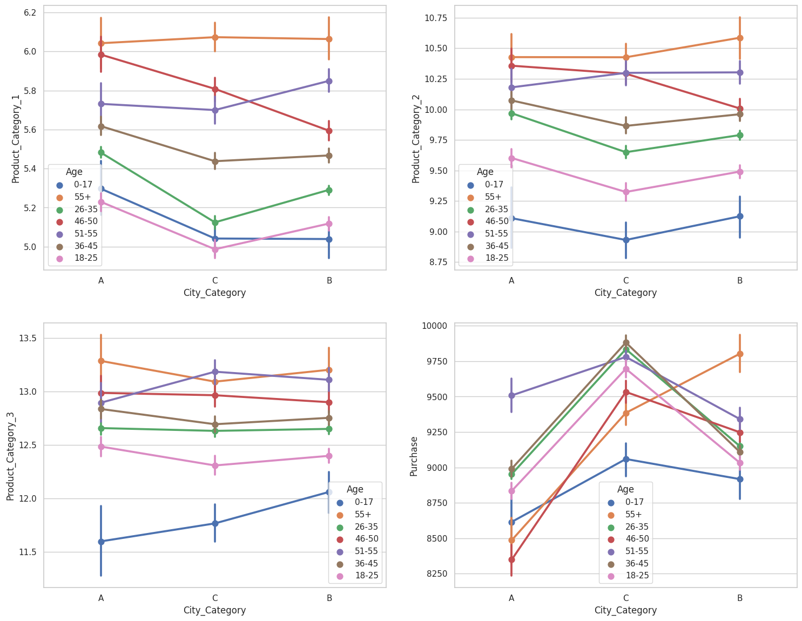
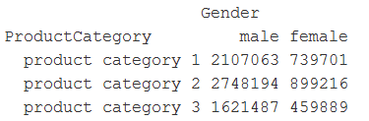
Point Plot Giving Idea About
The Stark Difference In The Purchase Across
City Categories For The Age Group Of 55 And Above.
It Is Highest In City Category B, As Compared To
The Other Age Groups Which Tend To Show
High Purchase In City Category C.
As Product Category Increase The Age Grp Color
Is Increasing Shows The Lower Product Category
Product Is for Smaller Age Group As We Go Up
The Age A was Increasing And Product Category Is
Also Increasing .
The company provide product categories or design
that the Way so that will easy to segregate products
As per customers .

Slide 18
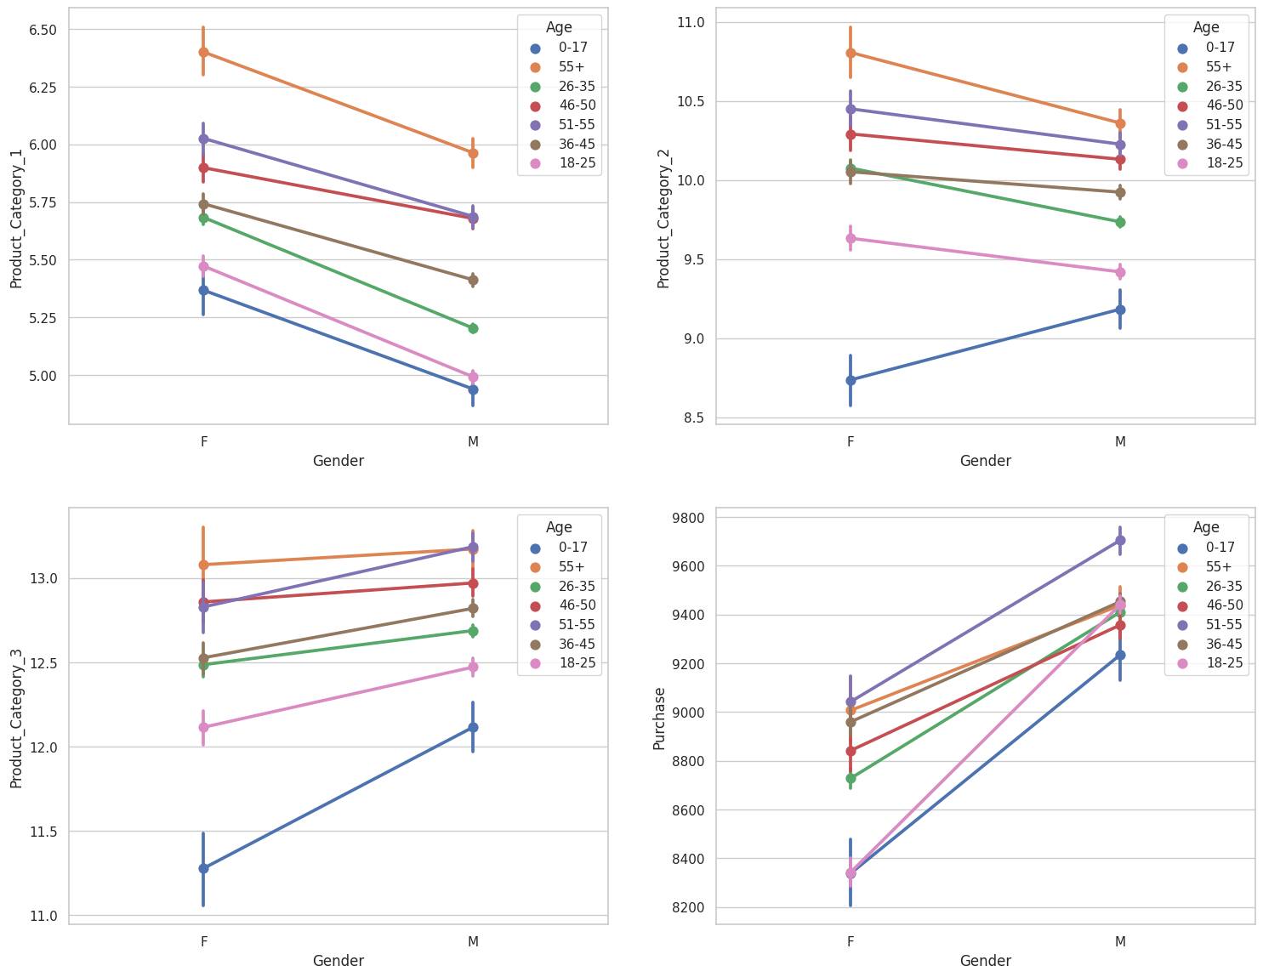
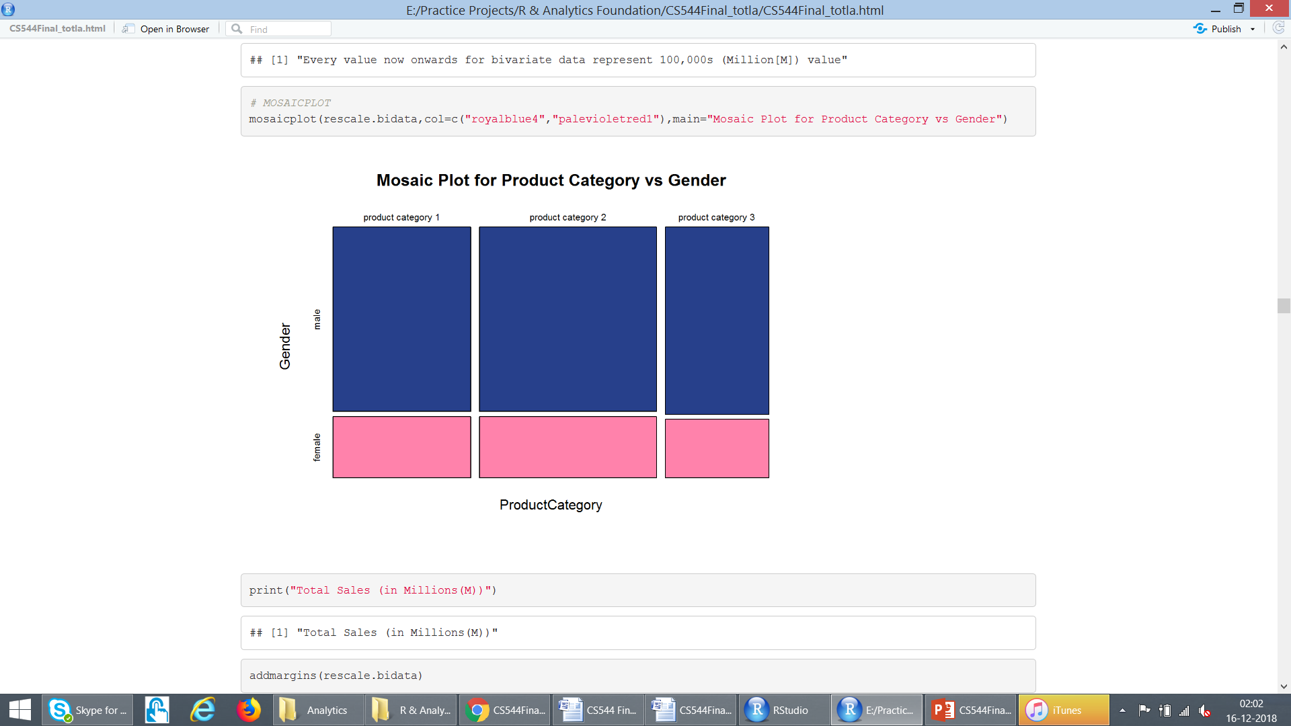
Where As Per Gender If See Male Contribution's
More Product Purchases .
In Every Product Category Both Gender Having Equal Interested . We Can As Per Age Chaining Increasing The Number Assign
For Product Is Also Increasing ,So We Can Say
The No Assign To Lower Category Of Product I S As Per Age .

Slide 19
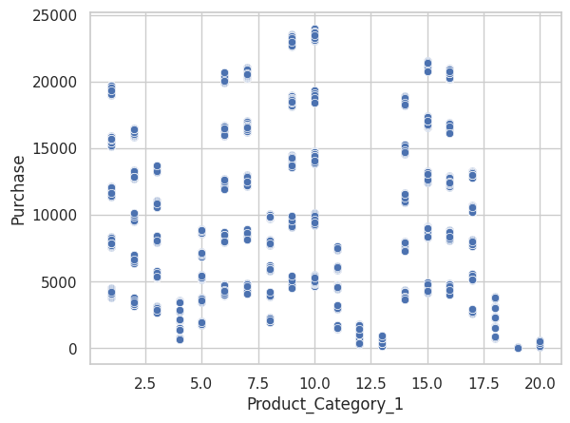
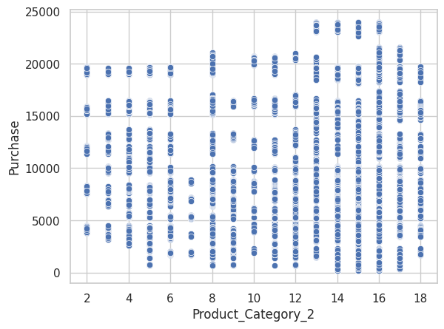
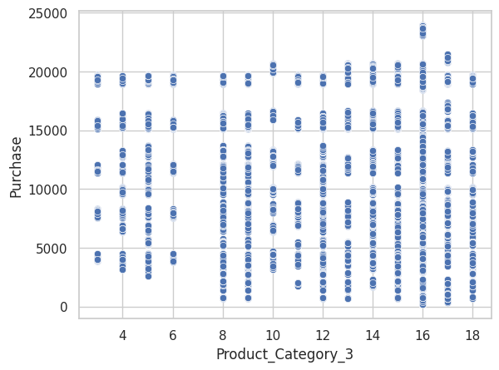
As we saw in previous slides this as an proof where 0-17 age people buy less products
after as age increasing customers are ordering More product .
Their need was increasing
Having good offers
Loyal customers
Customers who buys only at black Friday sales only

Slide 20
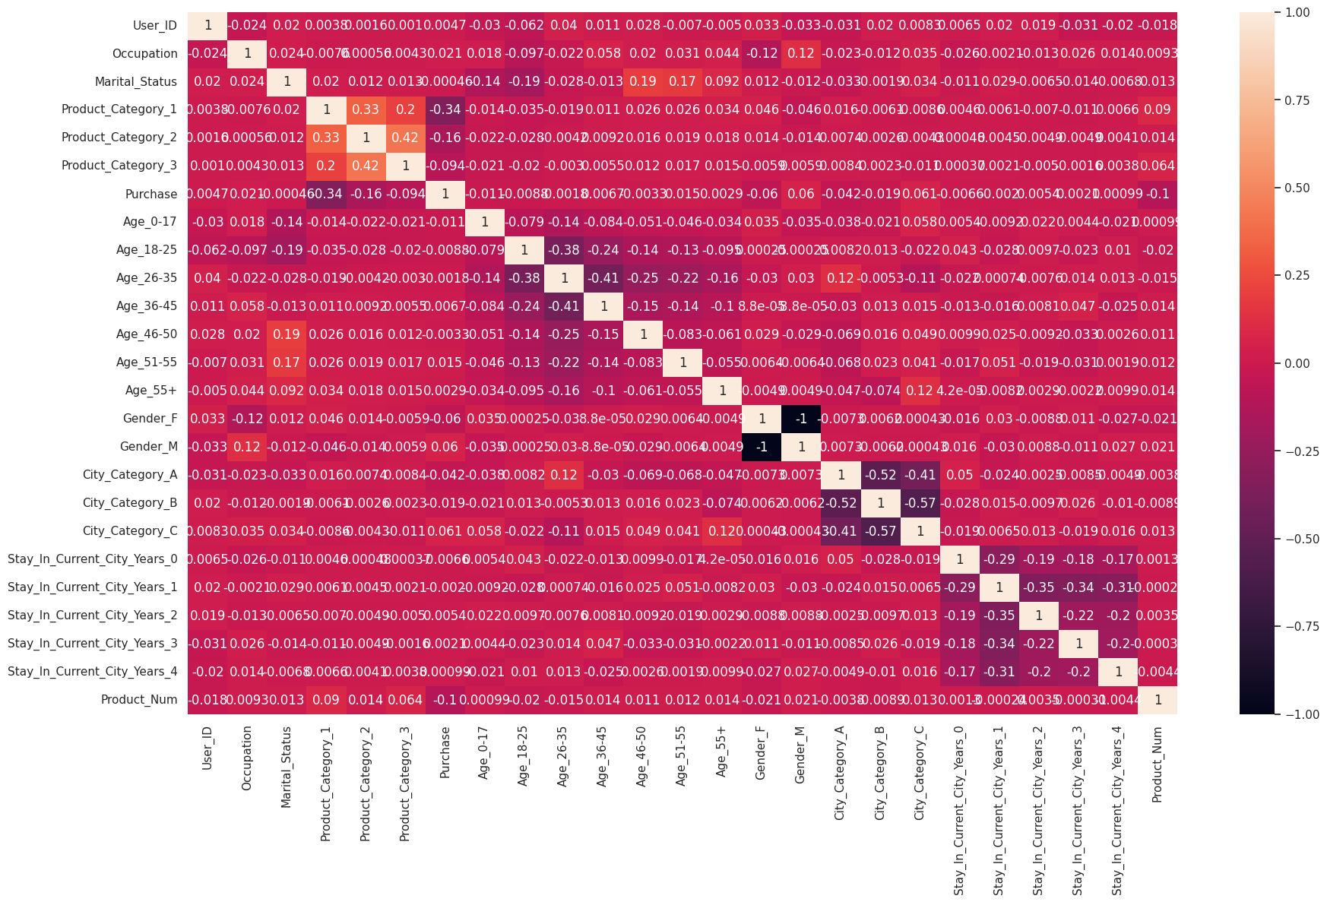
Features Correlation
After Observation We Can Say Every Feature Is
Contributing In Purchase .

Slide 21
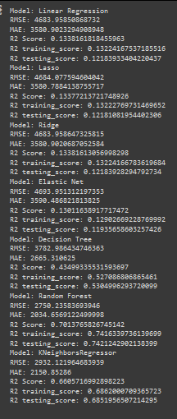
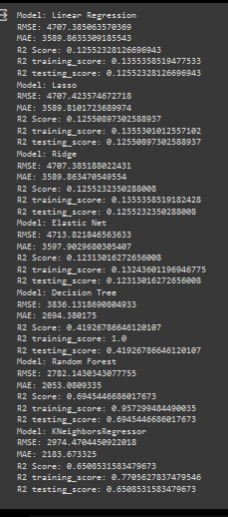
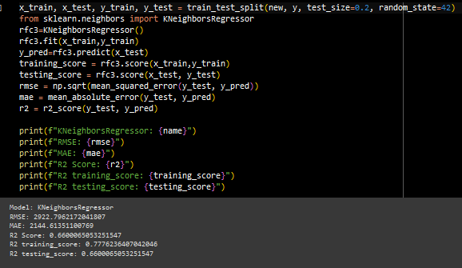
Nan Value Treatment
With Mode With Median
Chosen Model For Predicting Purchase Was KNN Repressor
With Default Parameter Having Less Residual Than Other
Regression Algorithms The Model Was Over Fit But Having
Good Accuracy Than Other .

Slide 22
Future scope
We Can Build Recommendations Engine With Help Of Association Rule And Apriori Algorithum By Similar Customer Behavior We Can Recommend Them Product .
We Can Predict Product Category Which Have To Sell In Future And Which Have Less Sale We Can Improvised Their Sell Buy Giving Them Offer.
We Have To Add More Product For Female Gender .

Slide 23
Conclusion
Number Of Male Shoppers > Female Shoppers
Products In Product Category 2 Sold Most
People Generally Spent Over $5000 In Sales
People In Age Range 26-35 Purchase Most
There Are Highest Average Sales In City Category ‘C’ As Compared To Other
Unequal Probability Sampling Technique Could Be Used Over This Dataset For Best Results
As Per Customers We Can Find Similar Id With Showing Similar Properties We Can Suggest Them Product Or Recommend Them New And Related Product
We Can Increase Demand Of Product Which Having Repetitive Order Buy Giving Them Offers ,Deals ,Prime Customers ,Prior Sales ,Limited Time Sales ,Etc

Slide 24
Thank you!! Questions?

Slide 25
Feel free to connect me
Linkedlen : https://www.linkedin.com/in/suyog-hole-b31066132/
Instagram : https://www.instagram.com/_suyog_hole/

